Slide 1
Love Forever – A Heartfelt Digital Expression of Endless Love
Ritu️
Awdhesh
❤️️

Slide 2
1
Dedicated to Ritu & Awdhesh
Introduction
2
A heartfelt digital love letter crafted with pure frontend code.
3
Blends emotion with creative coding.

Slide 3
Transforming frontend code into a poetic expression of endless love.
1
Project Idea
2
Using animations to capture emotions words can’t always hold.
3
A dreamy sky filled with stars, hearts, and love.

Slide 4
1
A night sky that comes alive with movement.
Core Concept
2
Love expressed through:
Stars
Moon
Hearts
Messages

Slide 5
1
Background – Night Sky
2
Moon – Peace & Presence
Creative Elements Overview
3
Stars – Memories & Hopes
Falling Star – A Dream in Motion
4
5
Floating Hearts – Endless Affection
6
Love Letter – Words of Emotion

Slide 6
Night Sky with Radial Gradient.
1
Background
2
Deep gradient = calm, infinite love.
3
Sets the mood for peace & eternity.

Slide 7
Symbol of steady presence.
1
The Moon
2
Fixed in the corner, glowing softly.
3
A reminder of love’s constant presence.

Slide 8
100 twinkling stars.
1
The Stars
2
Gentle flicker = secret wishes & memories.
3
Represents countless tiny promises in love.

Slide 9
A wish in motion.
1
The Falling Star
2
Smooth glide across the sky.
3
Symbolizes that true dreams of love never fade.

Slide 10
30 pure CSS hearts.
1
Floating Hearts
2
Drifting upward endlessly.
3
Sign of affection always rising & growing.

Slide 11
"Love Forever…" text animation.
1
Heartbeat Title
2
Words pulse softly like a real heartbeat.
3
Adds life & emotion to the promise of forever.

Slide 12
1
Soft pink central box.
Love Letter Box
2
Holds handwritten-style messages:
“Without you, my heart feels incomplete…” – Ritu
“Your presence means everything to me, my lovely Ritu…” – Awdhesh

Slide 13
Gentle promise rising from bottom.
1
Floating Message
2
Symbolizes love always lifting higher.
3
Keeps appearing = eternal bond.

Slide 14
A subtle grounding strip.
1
Bottom Strip
2
Ties visuals together.
3
Gives balance & closure to the scene.

Slide 15
2
HTML structure & layering.
Technical Highlights
3
CSS animations & transforms.
Motion design & positioning.
4
5
Minimal JavaScript for random stars/hearts.

Slide 16
1
Where this project fits:
Creative coding portfolio piece.
Digital greeting card.️
CSS animation practice.
Personal website Easter egg.
Blending design + emotion through code.
Use Cases

Slide 17
1
Beyond code, this project is:
Emotional Meaning
A symbol of everlasting connection.
Proof that love can be expressed in every form — even through code.
A reminder that emotions + creativity = true magic.

Slide 18
Starry skies filled with wonder.
1
Inspiration Behind the Project
2
Timeless stories of love & togetherness.
3
The thought: “What if love could be painted in the universe itself?”

Slide 19
1
Challenges Faced:
Balancing design & performance.
Creating natural animations without JavaScript.
Keeping code clean yet artistic.
Challenges & Learnings
2
Learnings:
Deepened CSS animation skills.
Improved visual storytelling through code.
Understood how to connect emotion + frontend technology.

Slide 20
“Love Forever is not just a project — it’s a story in motion.”
Closing & Acknowledgment
-Dedicated with respect & affection.
-A journey of love, creativity, and code.

Slide 21
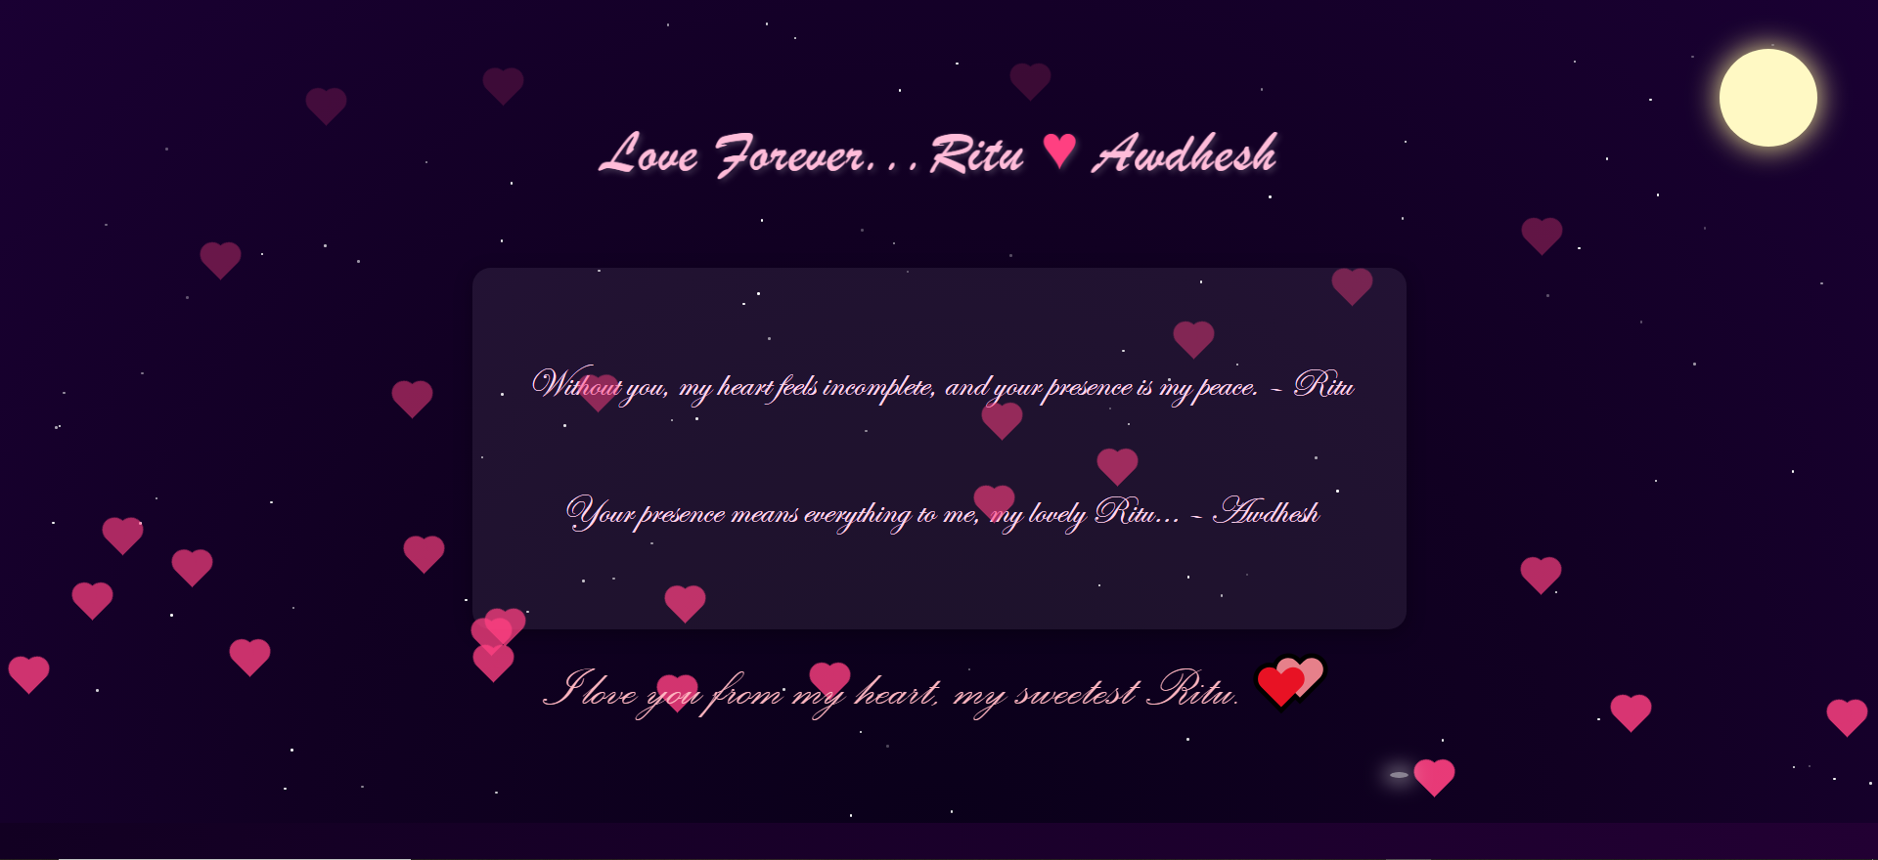
Project Overview

Slide 22


Slide 23
Thank you!
Every great presentation is complete with a great audience — and that’s you!

